Slide 2


Speakers
Riccardo Amadio Senior Data Engineer Agile Lab
Antonio Murgia Data Architect Agile Lab

Slide 3
COSA FA UN DATA ENGINEER?

Slide 4
COSA FA UN DATA ENGINEER?
SPOSTA I DATI DA UN PUNTO A … B

Slide 5
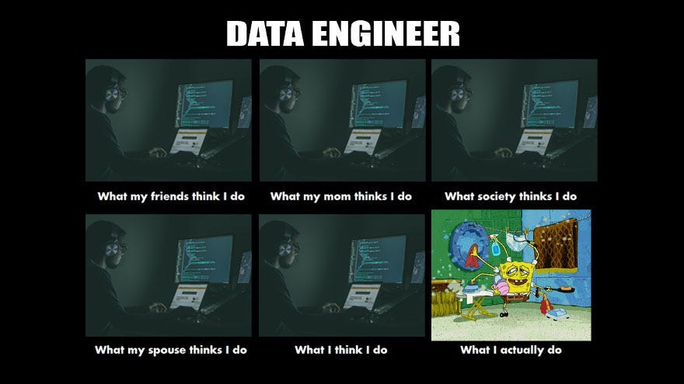

Slide 6
Data Engineering
Data Transformation
Data Security
Data Modeling
Data Quality
Data Integration
Data Architecture
FinOps
DevOps
Data Governance
Data Strategy
Data Analytics
Data Visualization
Data Science ( sometimes)

Slide 7
Come il Data Engineering è evoluto nel tempo
Relational Databases
SQL
Data Warehouse
OLAP
Spark & Hadoop
Redshift, BigQuery
ML Analytics & Data Lake
Modern Data Stack
We're here !
1960
1970
1980
1990
2004
2010
2015
2020

Slide 8
Come il Data Engineering è evoluto nel tempo
DWH ERA
BIG DATA ERA
CLOUD ERA
Relation Databases
SQL
OLAP
Data Warehouse
Spark
Hadoop
MapReduce
Big Data
NoSQL
HDFS
Cloud Data Warehouse
Redshift
BigQuery
Snowflake
Oracle
SQL Server
AI ERA
MODERN DATA STACK
ML Analytics
BI Dashboard
Databricks
Jupyter Notebooks
Sagemaker
Data Lakehouse
ETL
Query Engine
Data Visualization

Slide 9
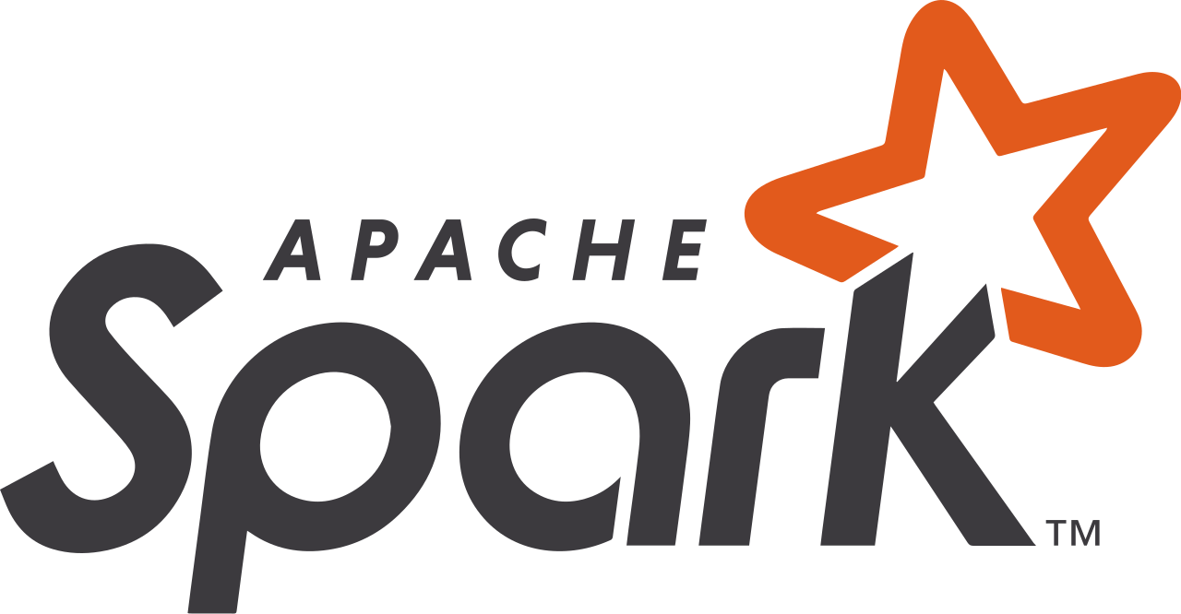
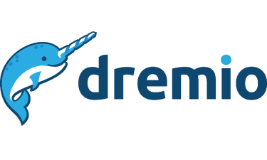
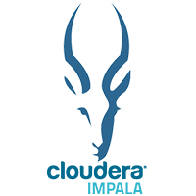

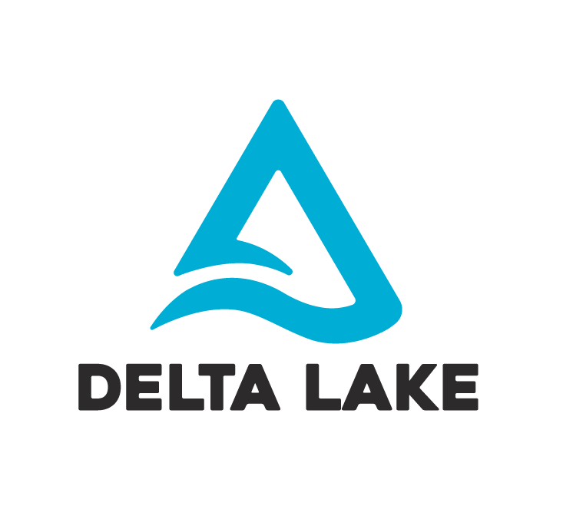
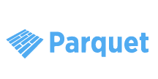
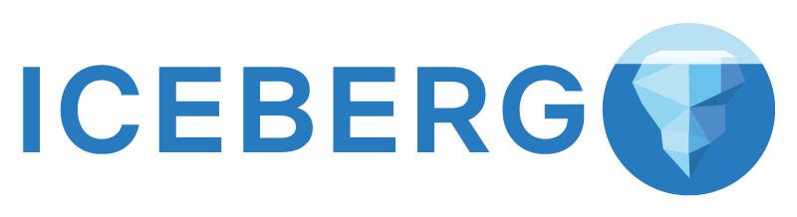

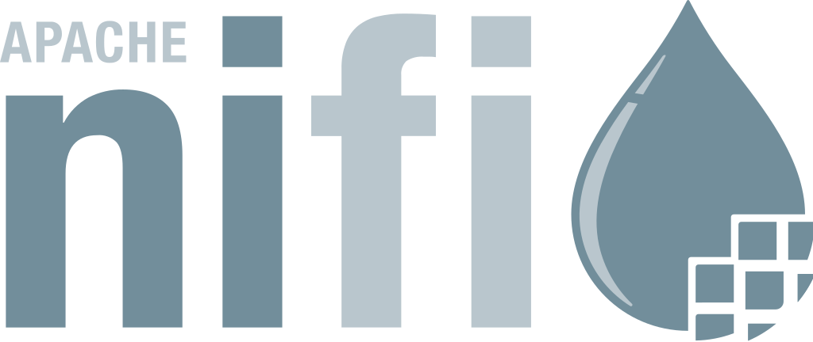
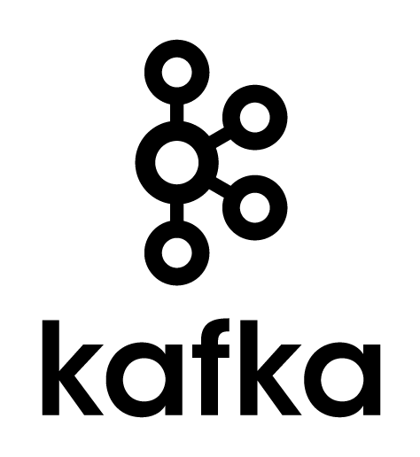
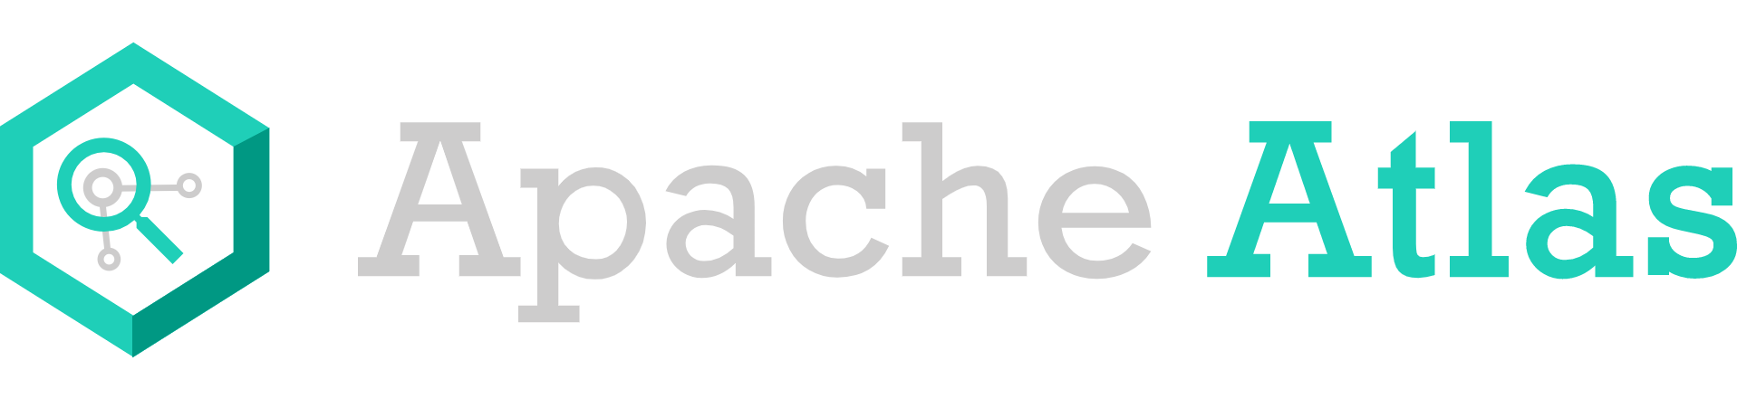

Data Architecture
Computational Layer
Governance
Ingestion Layer
Files & Tables (format)
S3
S3
S3
Storage Layer

Slide 10
Data Ingestion
Data ingestion can be very difficult to parallelize, mainly because of the dependency on the specific data source
Data streams
Operational databases
Plain files
Change Data Capture
Many available tools:
Open Source: NiFi, Camel
Cloud and Closed Source: AWS Glue, Azure Data Factory, Fivetran, Talend, Pentaho, Informatica
The transport technologies are more attractive from the parallelization standpoint
A new technological trend: parallel message brokers
Open source: Apache Kafka and Apache Pulsar
Cloud: AWS Kinesis, Azure Event Hubs

Slide 11
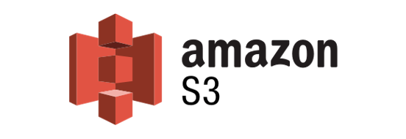
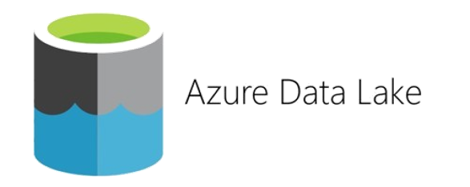
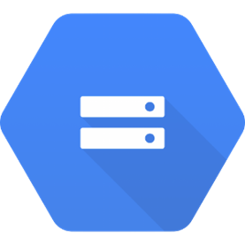
Storage Data - Cloud
Object-Storage Model: cloud
The three major cloud providers have an object storage offering:
Amazon Web Services: S3
Azure: Azure Data Lake Storage (Gen1, Gen2)
Google Cloud: Cloud Storage
Google Cloud Storage

Slide 12

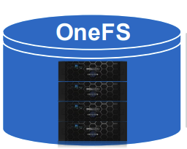



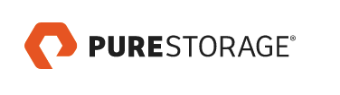
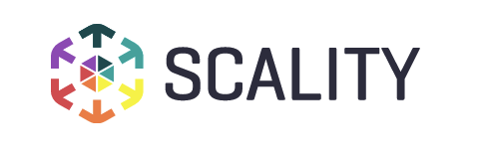
Storage Data – On-Premises
Object-Storage Model: on-premises
On-premise object storage systems are standardizing around the Amazon S3 API
Many vendors and options, either software or hardware-based
S3 as a de-facto standard => on-premises and cloud hybrid setup
Ozone

Slide 13
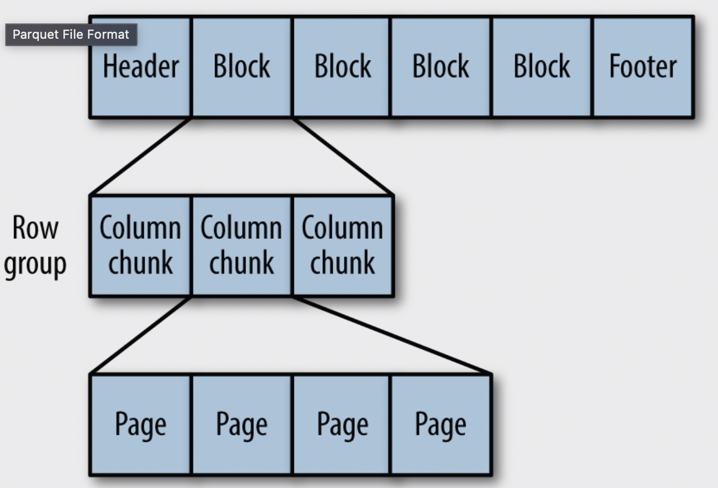
File Format
A file format is a way to store structured data together with its schema
Additionally, a file format supports different compression algorithms
Data could be held either row by row or column after column: row formats or columnar formats
Row formats: Thrift, Avro, Protobuf
Columnar formats: Parquet, ORC
{
"type": "record",
"name": "WeatherRecord",
"doc": "A weather reading.",
"fields": [
{"name": "year", "type": "int"},
{"name": "temperature", "type": "int"},
{"name": "stationId", "type": "string"}
]
}
Parquet is becoming predominant
Avro has been adopted by Kafka

Slide 14
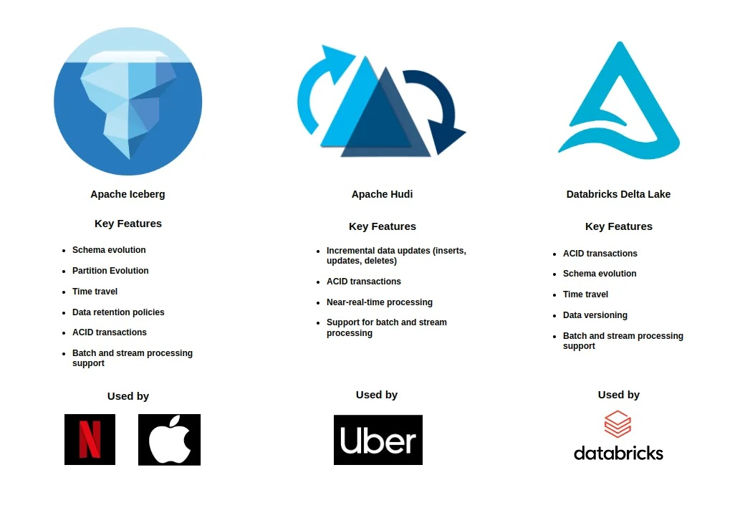
Table Format

Slide 15
Computation Layer
A BigData platform provides all the mechanisms for collecting, transforming, and delivering vast amounts of data
The intrinsic parallelism makes all those operations fast, scalable, and cost-effective
Transforming and querying data are the operations carried out by many available computational platforms
Those platforms collectively realize the computational layer of a BigData platform, and they can be divided into two categories:
Parallel SQL engines: Hive+Tez, Impala, Presto/Trino, Dremio, Snowflake, etc.
Parallel data processing engines: Spark, Flink, Ray, Dask, etc.

Slide 16
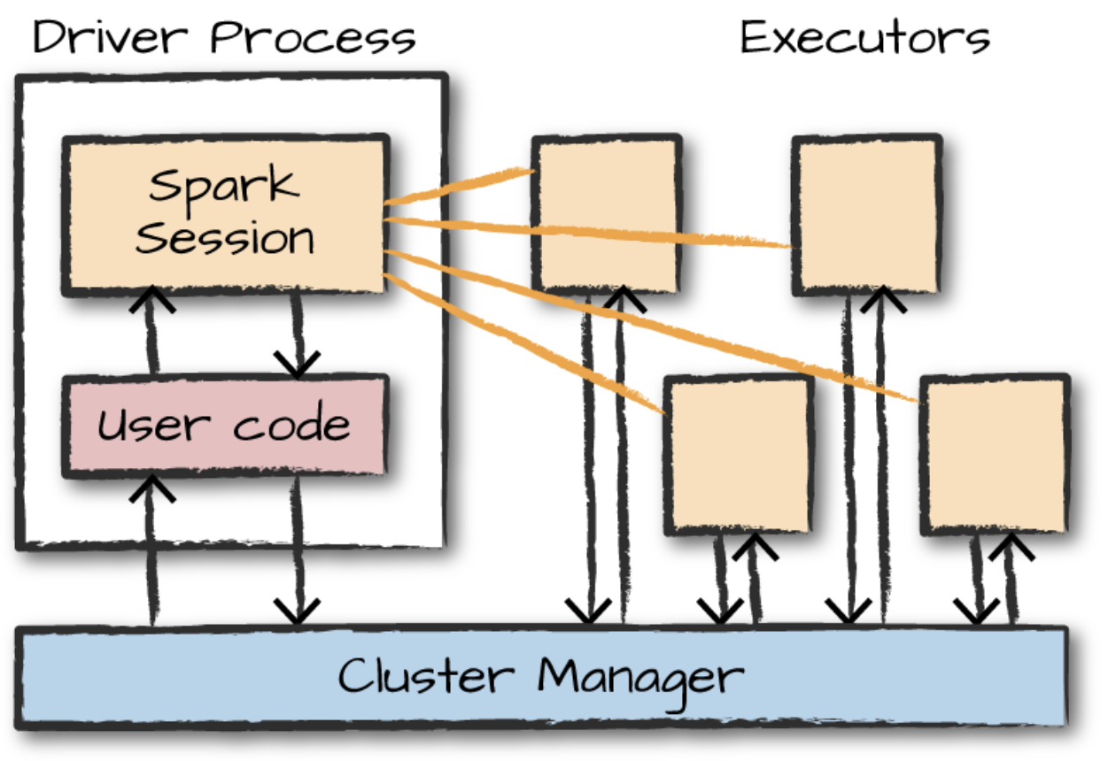
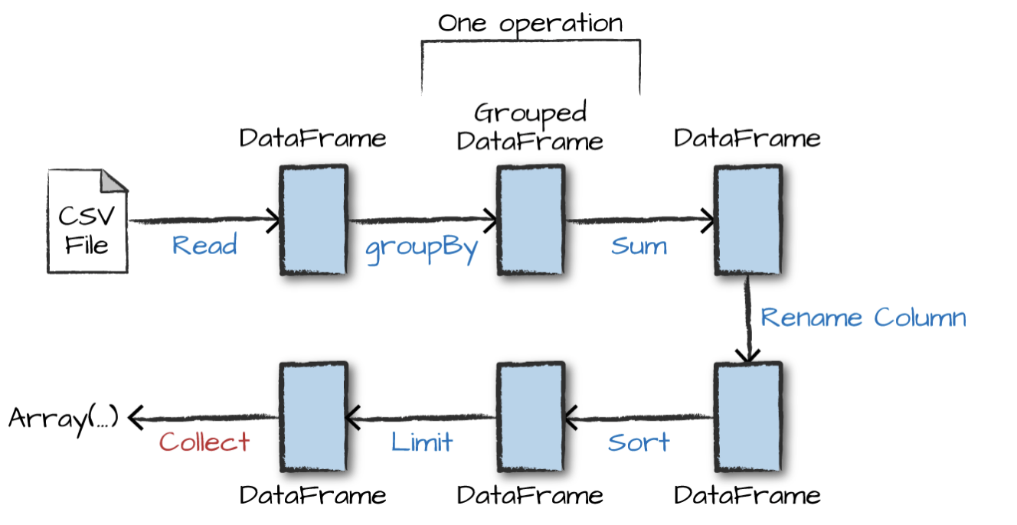
Computational Layer - Spark
Spark (https://spark.apache.org)
It supports Scala (it’s written in Scala), Python, Java, and R
It provides “functional” APIs for transforming list (RDD), list of records (dataframes and datasets)
The overall computation is described as a DAG (Direct Acyclic Graph) where the nodes are tasks that are executed by the computational nodes (executors)
The DAG-based approach for defining a parallel computation is standard across the different computational platforms

Slide 17
Computational Layer – New Technologies
Dask (https://www.dask.org)
It’s a Python-based parallel computing platform. It's purpose to replace Numpy,Pandas.
Ray (https://www.ray.io)
It’s a Python-based parallel computing platform: it supports different parallel computing paradigms, task, actors, and data parallelism
Specially suitable for distributed computation training and model serving. Not data intensive.
Arrow-based eco-system (https://arrow.apache.org)
Arrows is a language-independent for flat and hierarchical data, organized for efficient analytic operations on modern hardware like CPUs and GPUs
Many different languages with specific libraries for C++, Java, Python, etc., support it.
Around Arrow is growing an interesting eco-system of computing platforms:
DataFusion (https://arrow.apache.org/datafusion/ is a high-speed, extensible query engine for building high-quality data-centric systems in Rust, using the Apache Arrow in-memory format
Ballista, built on top of DataFusion (https://arrow.apache.org/ballista/), a sort of distributed version of DataFusion
Polars: a lightning-fast, single instance DataFrame library for Rust and Python (https://www.pola.rs)
DuckDB (https://duckdb.org) is an in-process SQL OLAP database management system. Read Data Intensive not Write Data Intensive.

Slide 18
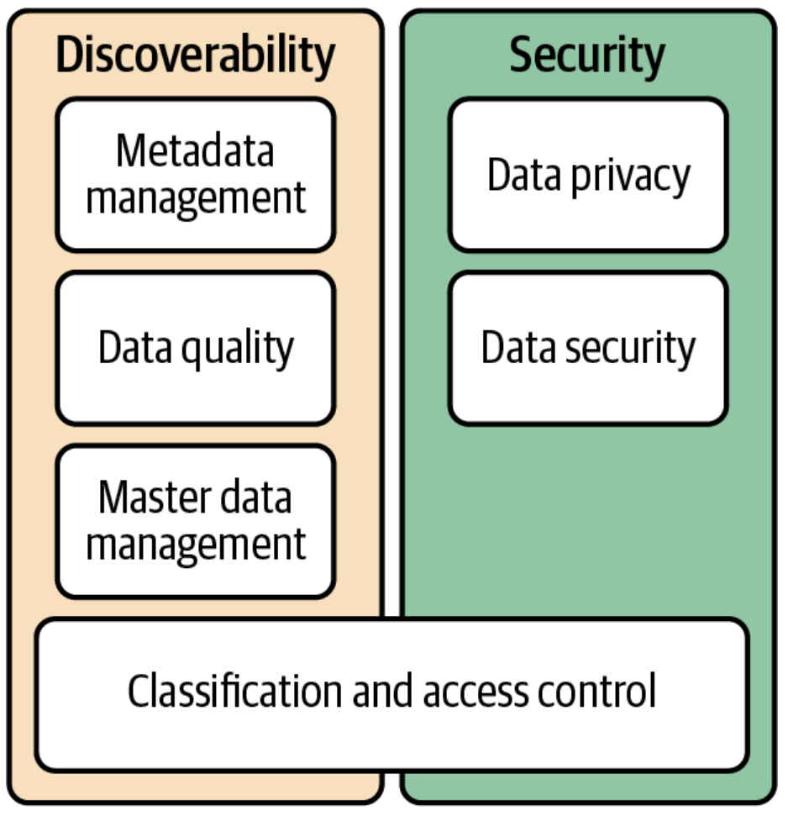





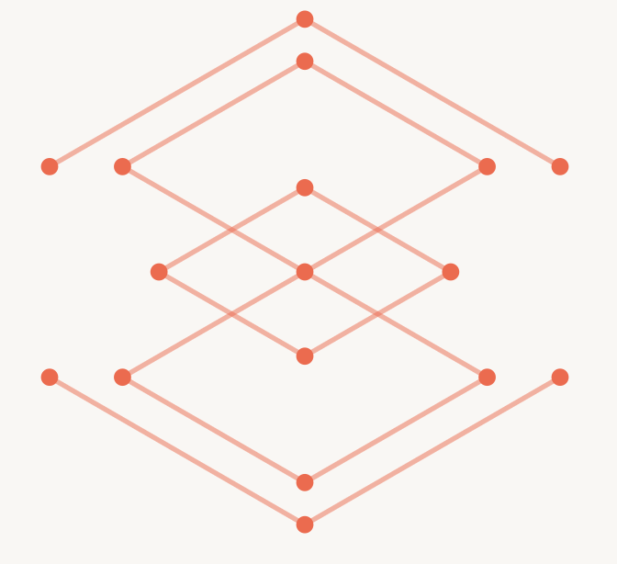
Data Governance e Data Catalogues
Governance: “a data management function to ensure the quality, integrity, security, and usability of the data collected by an organization”. Naming Convention and Organization.
The most critical piece is to have a data catalog.
A catalog is needed for storing all the metadata that qualify data from the semantic and security standpoint
Data Catalogues
Access Control & Auditing

Slide 19
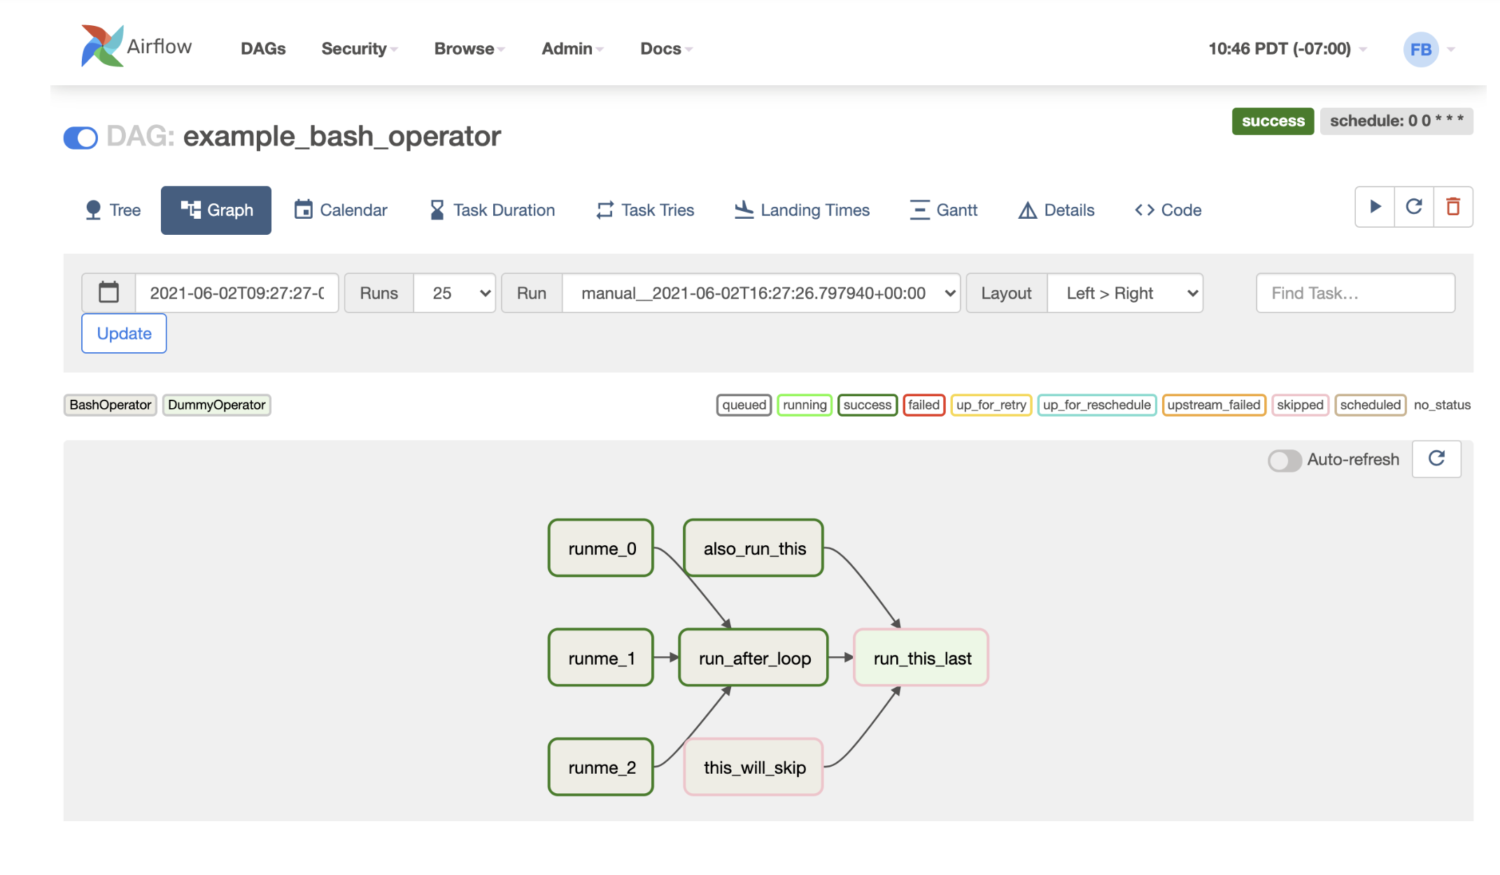
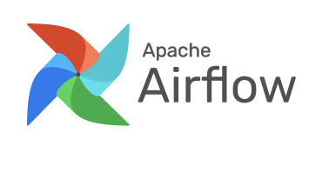

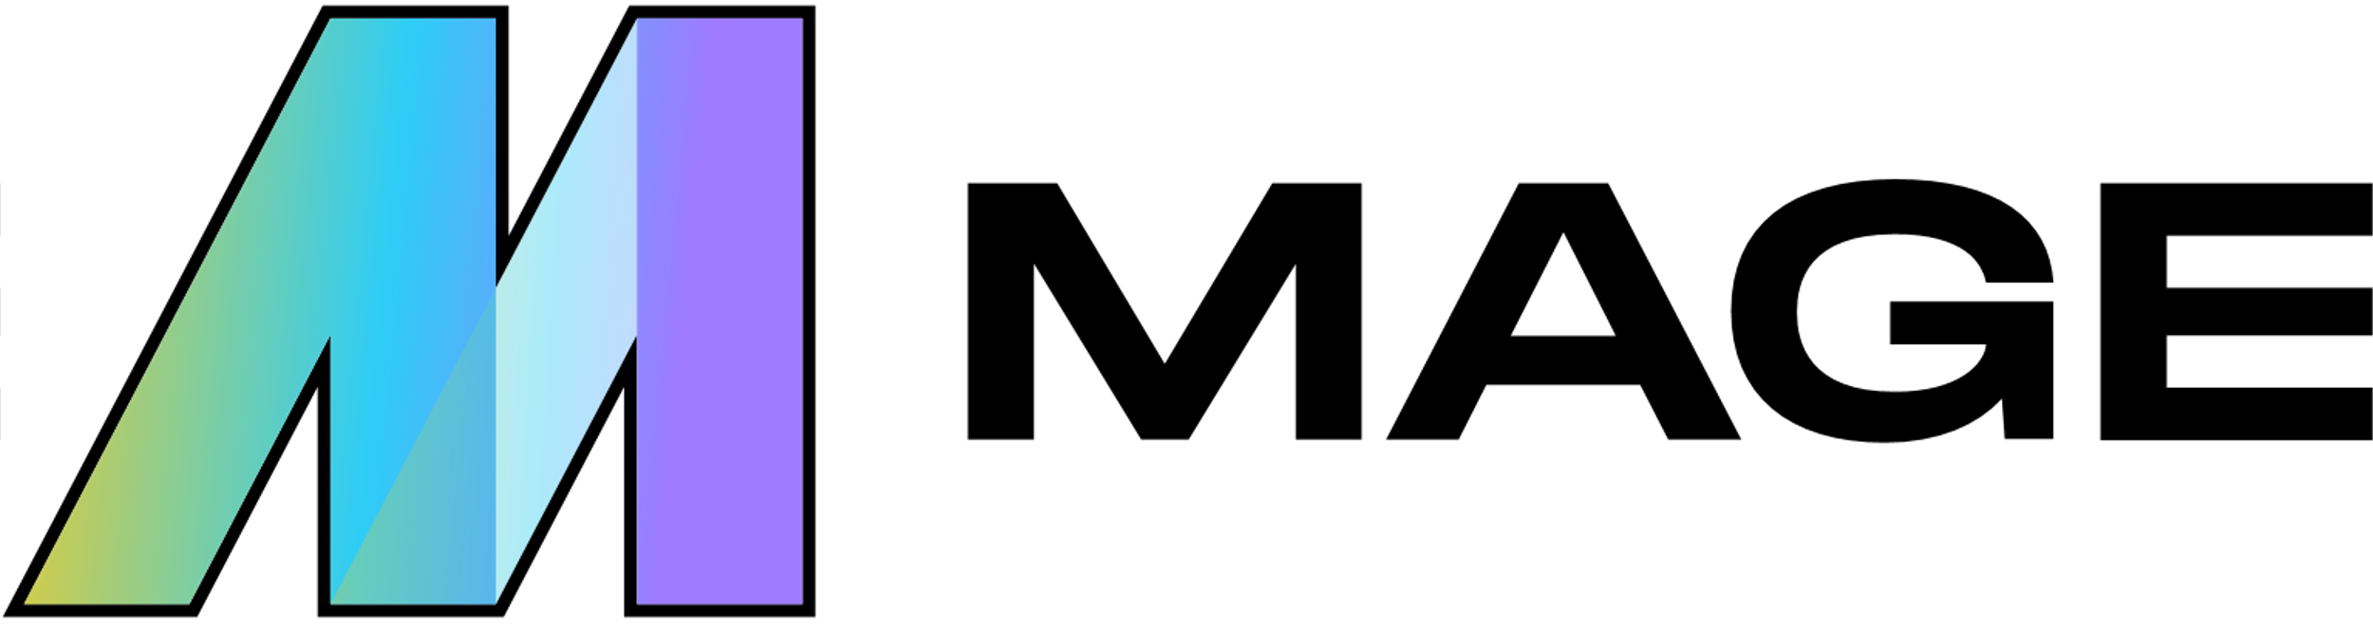
Data Orchestration
A BigData platform is a data refinery
It implements processes that refine raw data to more valuable/refined data
Valuable means data that provides actionable hints to improve business processes
A refinement process usually comprises single steps that must be orchestrated together
A single step can be a Spark job or an Impala/Dremio query; the orchestrator allows gluing all those steps into a data transformation pipeline

Slide 20
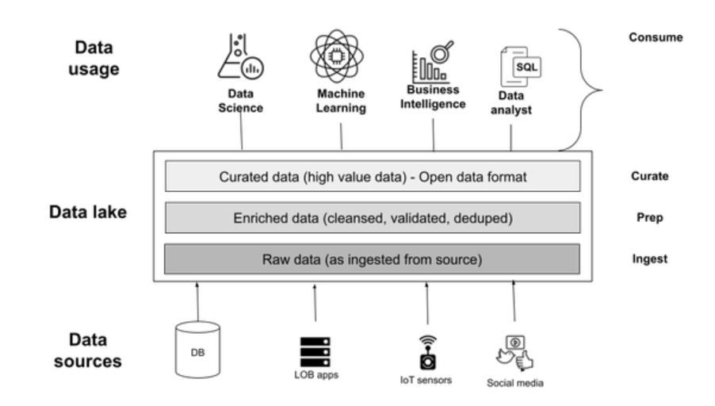
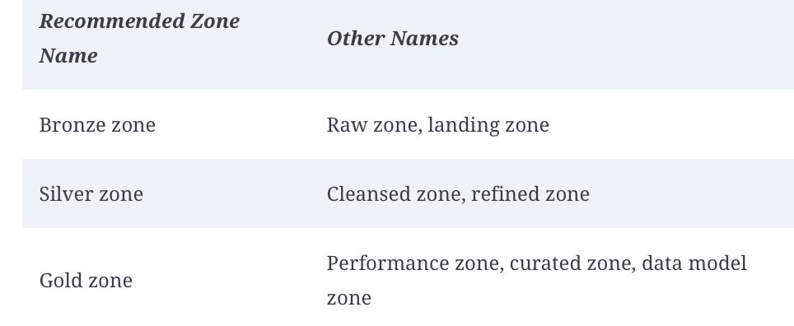
Data Refinement- Medallion
During the refinement process data is transformed and moved from a ”zone” of lower value to a ”zone” of higher value

Slide 21
Deployment environments: cloud, on-premises, cloud-native
Most enterprises are building their data platforms in the cloud with a combination of IaaC and PaaS
Fully managed platforms are rising to support enterprises in managing their data, like Snowflake, Databricks
Snowflake is built around an MPP SQL engine, Databricks uses Spark at its core
A trade-off between easiness and potential high costs and lock-in
On-premises still has its niche: data sovereignty, highly regulated use cases and when performance is paramount
Containerization and the advent of the cloud-native movement driven by the adoption of Kubernetes is a candidate to become a common abstraction among the different deployment environments
BigData on Kubernetes is getting increasingly popular and being pushed by the cloud providers as well

Slide 22

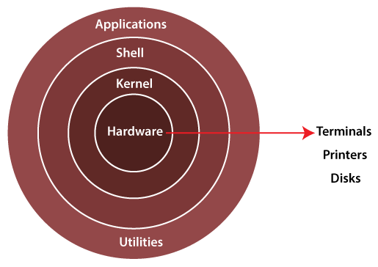



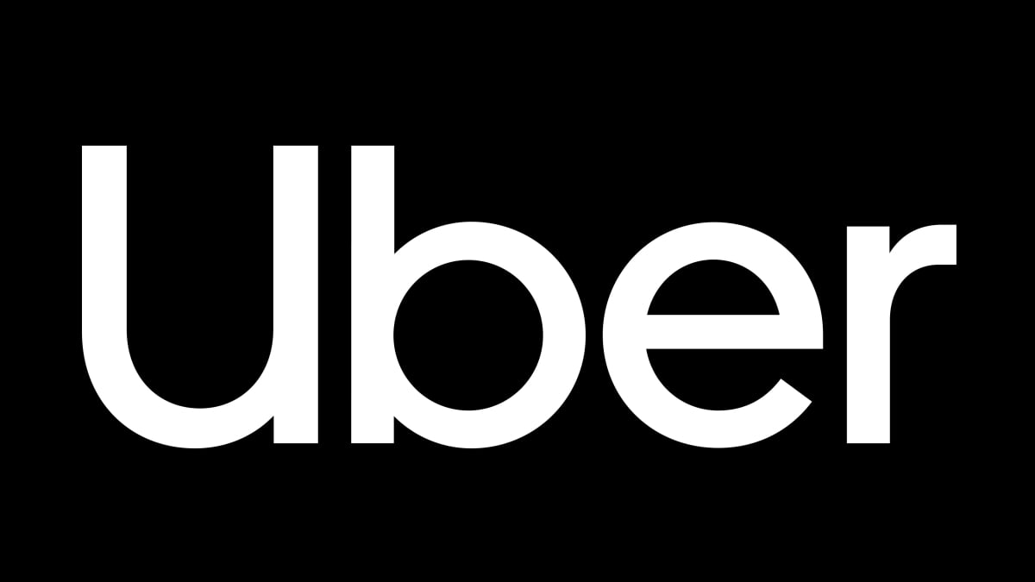
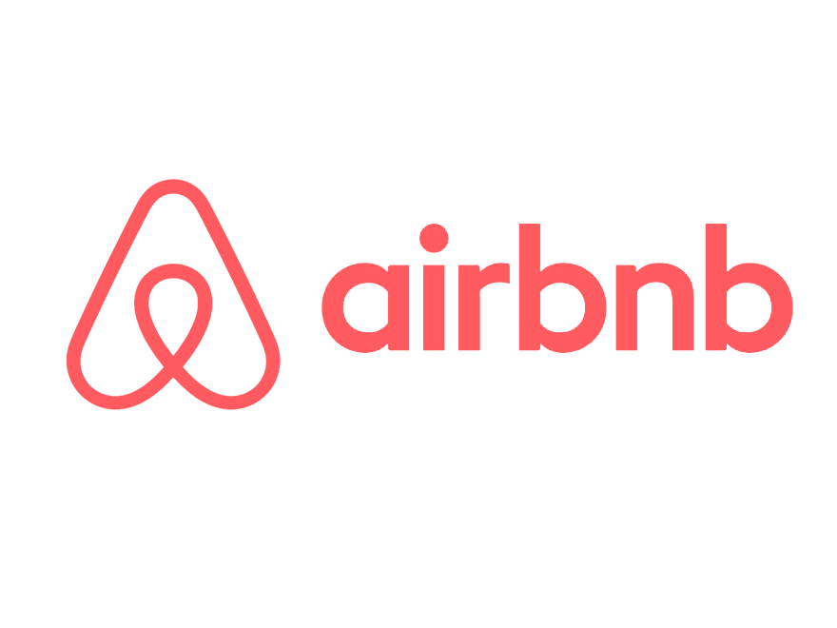


Data Platform
Technology Revolution
People
Processes
Technology
Technology Driven
Practice Driven
Isolated
Interoperable
Data as bits
Data as Value
Platform is a business model with the following characteristics:
Multiple parties can co-create and exchange value, they can also capture this value
Intermediary role: Acting as bridge and guarantee among parties
Network effect: the value increases exponentially with adoption
Scalability: can replicate the model in other business area
Seller defines its offering
22

Slide 23
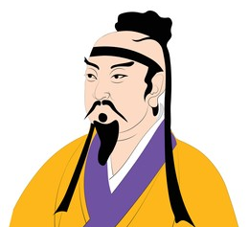
From Output to Outcome
Output
Outcome
Business Need
Report
Business Need
Data Product
Business impact and ROI
Spot value
Long lasting value
Value only for demand
Value for the entire company
Strategy without tactics is the slowest route to victory. Tactics without strategy is the noise before defeat.

Slide 24
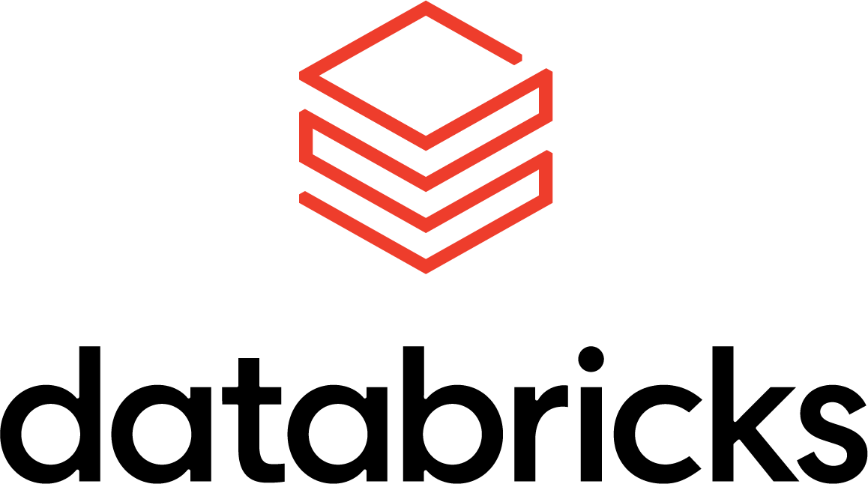

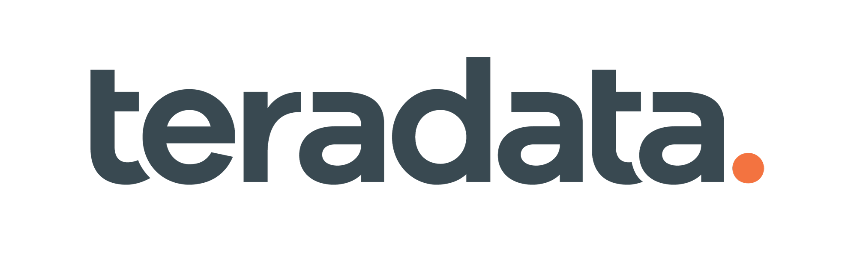
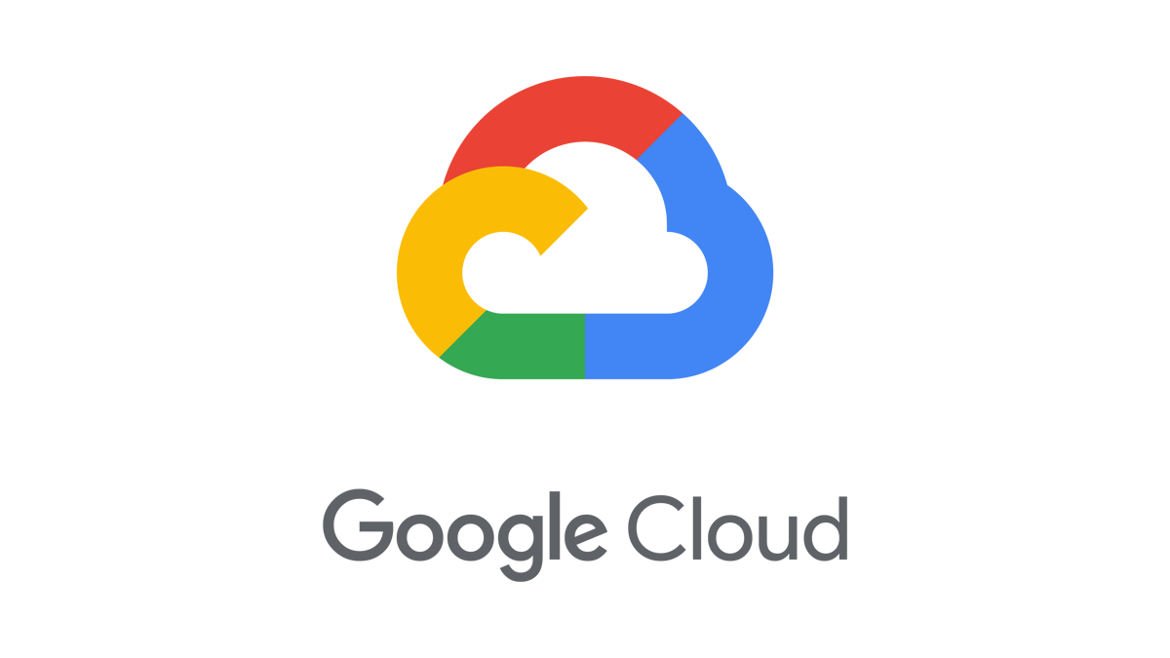

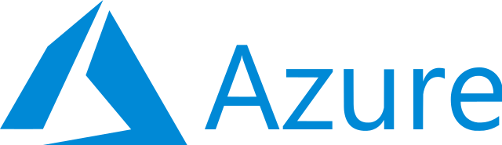
Processes
Consistent experiences across several platforms, no need to learn and know specific procedures and processes to manage the lifecycle of a data initiative from the inception to runtime
All the experiences done with a reduced cognitive load, improving the effectiveness and productivity of data engineering, reducing tech + data debt
All the experiences are empowered by metadata activation and automation
Process Plane - Experiences
Create and setup a project
Create metadata
Governance compliance
Make a release of the project
Deploy a project
Discover Data
Request access to data
Understand reliability of data
Data interoperability
Data interoperability
Multi-platform
Multi-cloud

Slide 25
People
Data Team
Templates and blueprints
Data Products
Platform Team
Data Consumers
Computational Policies
Metadata activation
Governance Team

Slide 26
Virtuous
Cycle
The platform introduces a unique and compelling value proposition that addresses a specific need or solves a particular problem for users
The platform introduces a unique and compelling value proposition that addresses a specific need or solves a particular problem for users
Value proposition
Initial adoption
Increased supply
Competitive differentiation
Wider Consumer Adoption
Value amplification
Reinvestment and growth
The platform reinvests the value generated (in terms of profits, data, feedback) to further refine and expand its offerings, leading back to the enhanced value proposition and continuing the cycle.
Early adopters recognize the value provided by the platform and start using it. Their positive experiences and feedback draw attention to the platform.
Early adopters recognize the value provided by the platform and start using it. Their positive experiences and feedback draw attention to the platform.
As more consumers and providers interact on the platform, they co-create additional value. This could manifest in the form of network effects, data insights, community building, and more.
Seeing the growing user base, more providers (or sellers) are attracted to the platform, leading to a diversified and abundant supply.
Seeing the growing user base, more providers (or sellers) are attracted to the platform, leading to a diversified and abundant supply.
The enhanced offerings and competitive advantages lead to broader consumer interest and adoption. Word-of-mouth, reviews, and recommendations further amplify the platform's reach.
With an increasing number of providers, there's healthy competition. This competition drives innovation, better pricing, and improved quality, further differentiating the platform from competitors.

Slide 27
Platform is a product
Product team
Product team
Product team
Customer oriented
As a service model
Market research
No ad-hoc features
Customer support
Customers
Platform

Slide 28



Thank you!
Next
Steps?
www.agilelab.it
@agilelab_official
linkedin.com/company/agile-lab
@agilelabsrl

